Slide 1
Championing Transparency and Ethical Leadership: Building Defences Against Fraud
Dr. Andrew T. Nsamba
MBchB, ACCA, CPA, CISA, ICCI, MSc

Slide 2
Introduction
Fraud is deception intended to result in financial or personal gain
Fraud is a betrayal of trust.
And while systems matter, while technology matters, while regulations matter—it is leadership that ultimately determines whether fraud is prevented, tolerated, or even enabled.

Slide 3
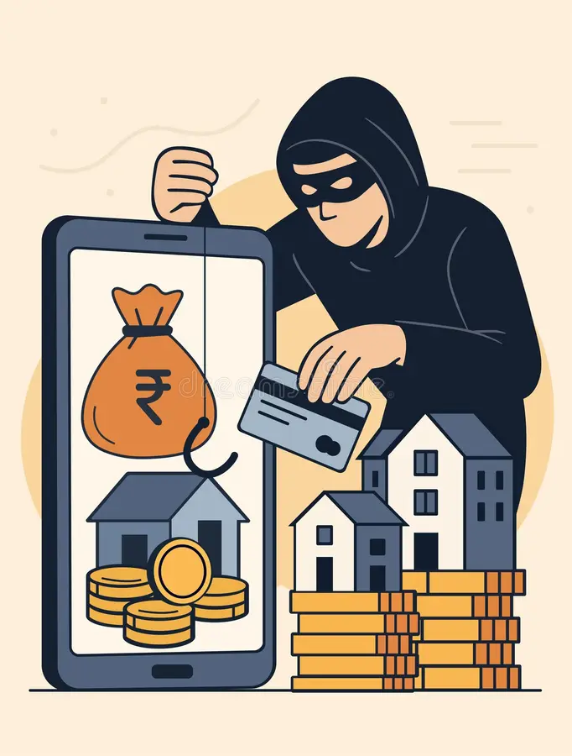
Fraud Landscape
Opportunity
Pressure
Rationalisation
Culture

Slide 4

Ethical Leadership
Leading by example
An ethical leader does not say, “Do as I say.”
They say, “Do as I do.”

Slide 5
Transparency
Openness in processes
  Transparency is not about exposing secrets. It is about ensuring accountability
  Fraud thrives in darkness.
  In today’s world, technology enhances transparency
The Auditor General sells trust to the citizens :

Slide 6
Defences Against Fraud
Strong internal controls
Risk assessments
Training and capacity-building
Whistleblower protection
Tone at the top
Zero-tolerance policy
Collaboration among stakeholders

Slide 7
Conclusion
Let us remember:
Fraud is a slow poison. Transparency and ethical leadership are the antidotes.

